Slide 1
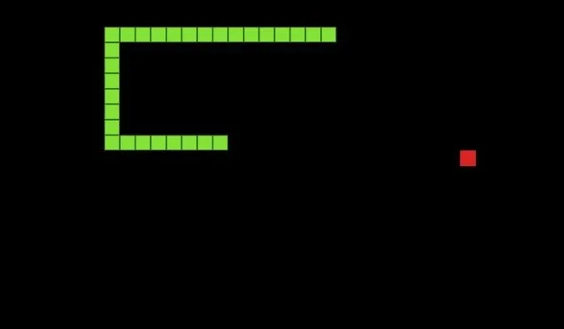
Snake Game
By: Emmanuel Marcial, Dawson Graf, Paul Yang, Justin Villamil

Slide 2

Overview
Recreated the classic arcade of Snake game on the NexysA7-100t
Utilizes the board’s RGB LEDs, PS2 receiving, VGA display, SSD, the board’s LEDs and the board’s switches

Slide 3
Sub-modules
se_clk_div.v
Uses a clock signal of 100MHz
A counter keeps a record of how many times the clock signal has been high where it will flip once the counter equals the div_value for the desired clock, outputting a divided_clk
SSG_control.v
Seven-segment controller that controls what common anode and cathode will be displayed based on pre-programmed outputs

Slide 4
Sub-modules
randomGrid.v
Utilizes a high frequency of clock in which the human eye cannot perceive on its own
VGA_gen.v
Continuously checking the VGA monitor pixel by pixel for its 640x480 display
X-axis being 0-799 and Y-axis being 0-524

Slide 5
Sub-modules
PS2Receiver.v
Receiving keyboard inputs and converts it into a 32-bit binary
Uses Debouncer.v in order to filter any unwanted signals
Uses a counter to determine a user input when it reaches 19, otherwise the temp value is overwritten with another input then the counter resets
Checks the negative edge of the clock and assigns data to a temp value while incrementing the counter to assign the next bit (outputting a group of 8 bits)
Uses decoder.v to maintain a constant direction

Slide 6
Sub-modules
pwmgen.v
Mimics an analog signal by affecting the duration of a duty cycle
Uses a counter that will continue until reaching the parameterized size where it will either remain the same or flip based on the duty cycle
pwm_top.v
Uses the pwmgen.v in order to display RGB LEDs based on the condition of the game

Slide 7
Top Module
Utilizes various clocks: CLK50MHz (PS2 receiver), VGA_clk (for the display), update (to update the snake’s direction), and slowclk (for updating the snake’s length and if it collides)
pwm_top.v is used to show when the player loses or wins the game through the RGB LEDs
SSG_control.v is used to display the score of the player (having a high-score of 16 to win)
VGA_gen.v generates the display for the game and randomGrid.v generates the positions of the random apples on the display
PS2Receiver.v uses the inputs of the keyboard to apply to the game on the VGA display
Utilize the board’s switches to change the snake’s color and button to reset the game

Slide 8
Thank you!

